Slide 1
Phased Retirement Program
2026-2029

Slide 2
Phased Retirement
The Phased Retirement Program (PRP) gives eligible, tenured faculty the opportunity to retire, yet continue
half-time employment for a three-year contract period.
Application Period: Sept. 20, 2025 - Feb. 16, 2026
Retirement Submission (TSERS/ORP): March - April, 2025
Those in phased retirement fully retire from the “state” (i.e. their mandatory retirement plan).

Slide 3
Eligibility
Tenured
Minimum 5 years of NC State service
Age 62 – TSERS
Age 59 ½ - ORP
Must Be Eligible to Retire

Slide 4
Work Plan & Pay
PRP duties are negotiated with Department Head/Dean. A PRP participant maintains their academic (9-month) or fiscal year (12-month) appointment length and works a half-time (50%) workload within it.
Work Plan should reflect a half-time (50%) workload
Does not reflect summer sessions for 9-month faculty
Should give the Provost Office useful context to indicate current responsibilities and how phased retirement will represent half-time employment (optional template)

Slide 5
Salary Calculation
50% of annual faculty base salary minus any administrative supplements
Salary is paid July – June regardless of when the PRP participant works
Faculty who hold administrative positions must retreat to faculty status upon entering the PRP

Slide 6
Summer Salary & Additional Comp
PRP participants may earn summer salary (9-month faculty) and additional compensation (9- and 12-month faculty) for tasks outside their work plans.
Exception: No summer salary for TSERS participants in the second summer school session of the summer they enter the PRP
TSERS faculty are responsible for staying within the earnable allowance (this information should be obtained through ORBIT annually by the retiree)

Slide 7
Half-Time NCSU Salary
Paid Monthly
Salary is paid July – June regardless of when the PRP participant works
Taxable income (Federal, State and FICA)
Some benefit deductions will stop:
TSERS/ORP
State Health Plan
Long Term Disability
Continued benefit deductions:
NC Flex Plans
UNC System Life & AD&D
MetLife Legal
Voluntary Retirement (403(b), 457, 401k)

Slide 8
Application Process
Faculty Member:
Reviews and completes the PRP Application and Re-employment Agreement
Submits the completed, unsigned application to their department head for discussion of the PRP work plan
Department Head:
After agreeing on the work plan, the department head will sign the agreement
The department head will pass the signed agreement to the dean for approval

Slide 9
Application Process
Dean
Reviews and signs the completed agreement.
Agreement submitted to UHR
After agreement is signed by Dept Head & Dean, application is submitted to UHR by the deadline (Feb 16, 2026).
Provost’s Office
All applications are submitted to Provost’s Office on Feb. 17th, not submitted prior to deadline.
Provost’s office reviews applications. Approval may take up to three (3) weeks. (No defined approval deadline)

Slide 10
Application Process
Provost’s Office cont…
Upon Provost approval, the faculty member will receive by email and regular mail, the finalized and signed Agreement and the General Release form
Faculty Member
Upon date of receipt, the faculty member will have 45 days to consider and sign the final Agreement
Must return both documents signed to UHR Benefits within this timeframe.
Once returned to UHR, Faculty member has 7 days to revoke their application and return to their position held prior to applying for the Program

Slide 11
Application Process
Faculty Member
Should a faculty member wish to revoke their application, a written intent must be submitted to the department head with a copy sent to UHR Benefits prior to the end of the 7 days revocation period.
Additional Notes:
Can be electronically signed by all parties.
Important: Faculty Member should not sign the application until after it is approved by the Provost office.
Forms should be scanned and attached in HR Now
General Release must be signed by the faculty member and notarized.

Slide 12
Professorship & Emeritus Status
Department Head can initiate the emeritus/emerita status approval process upon the Phased Retiree’s entry or completion of the program
Professorships of Distinction are relinquished upon entering the PRP
Except for Named Term Professorships, Professor of Distinction titles carry into emeritus / emerita status
REGs and SOPs re: emeritus status available at the Provost's website

Slide 13
Making the Transition
In March/April, the retirement process should begin with UHR Benefits. (Your retirement date will be July 1, 2026)
June 30, 2026
Final payroll for full-time employment
July 1, 2026
PRP begins
Relinquish tenure
Half-time employment/salary begins

Slide 14
Making the Transition
July 31, 2026
Coverage on NC State University group health plan ends
Final leave payout from NCSU and half-time pay
August 1, 2026
Health coverage begins on the State Retirement System group plan
If non-medicare eligible may continue same SHP coverage (expect as a retiree)
If Medicare-eligible, can enroll in the 70-30 plan or Humana Base Plan
Medicare A/B must be effective no later than July 1

Slide 15
Lump Sum Leave Payout (If applicable)
All annual leave hours up to 240 based on FTE
All historic bonus leave hours (2017 & 2018 Special Bonus Leave is not compensable at retirement and must be used or lost)
Annual salary ÷ 2080 = hourly rate
Hourly rate x total hours = payout
Paid in July payroll
Payout is taxable!
Subject to 6% TSERS or ORP contribution
Can defer to 403(b), 401(k) & 457

Slide 16
403(b), 401(k) and 457
403(b), 401(k) and 457 contributions allowed
Up to $30,500 per year, for each
Age 72 minimum required distributions (MRD) are not required during PRP period
IRAs and other non-NCSU retirement plans require MRD

Slide 17
Retirement Income
Teachers’ and State Employees’ Retirement System (TSERS)
- Traditional pension plan
- Defines a benefit upon retirement
- Employer/employee mix of money into a general pension fund
- Employee doesn’t bear any risk or control investments
- You can run retirement calculations in ORBIT
www.myncretirement.com

Slide 18
Retirement Income
Teachers’ and State Employees’ Retirement System (TSERS)
Retirement process is online, which is the most efficient method of retiring. The retirement application needs to be submitted in March/April, 2026
Enter a case in HRNow if you wish to request an appointment with a Benefits Consultant
Enrollment into a retiree health plan happens automatically. (30 days to change plans)
Receive first payment (check) on 7/25/2026

Slide 19
Break in Service
The Phased Retirement Program is exempt from break in service rules that otherwise apply to non-PRP TSERS retirees.

Slide 20
Retirement Income
Optional Retirement Program (ORP)
- Defined contribution plan
- Benefit is determined by investment performance of contributions
- Must be in receipt of a monthly benefit starting in July 2026 for retirees’ health insurance eligibility
- Several payment options are available
- Must meet with your ORP plan representative to discuss payment options and process a monthly distribution

Slide 21
Retirement Income
Optional Retirement Program (ORP)
Begin retirement process by April 3, 2026
Set up a meeting with a Benefits Consultant
Submit an ORP-3 Form in HRNow
Meet with ORP plan representative
Set up monthly retirement benefit payment in order to be eligible for retiree medical
Enrollment into a retiree health plan happens automatically. (30 days to change plans)

Slide 22
Taxation of Retirement Benefits
State of NC tax exemption (Bailey)
If you became vested in TSERS or began ORP participation prior to August 1, 1989
Retirement benefits will never be taxable as long as your primary residence remains in the state of NC
Or if your primary residence changes to a state with no state income tax!

Slide 23
Taxation of Retirement Benefits
Federal Taxation
A small portion of your retirement benefit may not be federally-taxable
Amount of benefit based on contributions made prior to July 1, 1982
Contributions were made on a post-tax basis

Slide 24
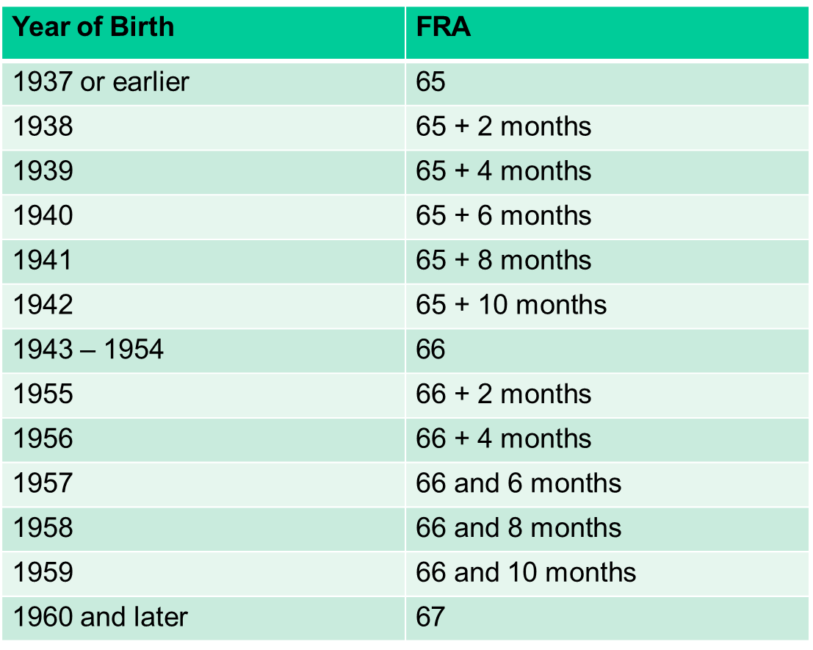
Full SSA Retirement Age

Slide 25
Social Security Retirement
If you are under full retirement age for the entire year (minimum age 62)
$1 for every $2 you earn above the annual limit is deducted from monthly SS payment
$ 23,400 is the earnings limit in 2025 (2026 not released)
Your retirement benefit does not count as earnings

Slide 26
Social Security Retirement
In the year you reach full retirement age
$1 in benefits is deducted for every $3 you earn above the earnings limit
2026 anticipated limit $62,160 (not official)
Only earnings before the month you reach your full retirement age count!
No earnings limitation applies starting with the month you reach full retirement age
Apply online, at www.ssa.gov

Slide 27
SHP and Medicare
If age 65 or older when entering PRP, you must be enrolled in Medicare A and B as of July 1
NC State can provide an employer statement showing why Medicare B was delayed due to participation on an employer group health plan upon request for you and your spouse.

Slide 28
SHP and Medicare
Medicare enrollment is automatic if you’re in receipt of Social Security retirement payments
If not, enroll within 60-90 days before turning age 65
Medicare Part B premium is deducted from your monthly Social Security retirement payment
If you’re not drawing Social Security retirement at age 65, Medicare will bill you directly for Part B

Slide 29
Retiree Health Insurance
If over age 65 at retirement:
Prior to your retirement, you will be defaulted to a Humana Medicare Advantage base plan
You will have 30 days to change the coverage to the enhanced Medicare Advantage plan or the 70/30 health plan

Slide 30
Retiree Health Insurance
If under age 65 at retirement:
You will continue on your current State Health Plan.
Your group will change to the Retirement System.
New health insurance ID cards will be issued with the group number starting with “SR”.

Slide 31
Retiree Health Insurance
Payroll deducted premiums stop in July for August coverage
If TSERS: dependent premiums are deducted from monthly TSERS retirement payment
If ORP: you will receive a bill from Itedium (contracted by SHP to do retiree health billing)
SHP resources are available on their website

Slide 32
Exiting Phased Retirement
The PRP participant may exit the Program prior to the end of the 3 year contract period, with written, mutual consent between themselves and the department head/dean.
They may continue employment with NC State, following the completion of the 3 year PRP contract period.
Note: No break in service following Phased as typically required for TSERS retirees.

Slide 33
Phased Retirement Timeline Recap
Application Process
Sept. 20- Feb. 16
Application Period
Dept Head & Dean Sign, submit to UHR (EE does not sign)
Feb 17- TBD
Reviewed & signed by Provost Office (Approx 3 weeks)
45 Day Period
Waiting period for EE to review, sign, & submit final doc to UHR
7 Day Period
Revocation period for EE to revoke application
Retirement Process
March - April
Phased retirees meeting with Benefits Consultants to initiate retirement process w/ TSERS/ORP
April-June
Phased Retiree working with TSERS/ORP to finalize retirment
July 1, 2026
Enter Phased retirement (notifications sent to dept by June 1)

Slide 34
Resources
Phased Retirement Webpage
Sept. 2025 Eligibility Announcement
Phased Retirement Dept Guidelines
Reg 05.57.01- Phased Retirement Program
PRP FAQs
PRP Presentation to Eligible Faculty
Phased Retirement Agreement
Workplan Template
Benefit Plans on Phased:
TSERS Participants
ORP Participants

Slide 35
Resources
Teachers’ and State Employees’ Retirement System and ORBIT portal:
www.nctreasurer.com
Click on Retirement
Click on ORBIT
Register to create username & password

Slide 36
Resources
TIAA (ORP & 403(b/457))
www.tiaa-cref.org/uncorp/
www.tiaa-cref.org/unc403b/
1-800-842-2776
Donna King
704-988-1302
donna.king@tiaa.org

Slide 37
Resources
Supplemental Retirement Plans
401(k) and 457/Deferred Compensation:
www.ncplans.prudential.com
Christy Kelly, CRC christy.kelly@empower.com
(919) 602-8226

Slide 38
Resources
Social Security Retirement and Medicare
www.ssa.gov www.mymedicare.gov
4701 Old Wake Forest Rd, Raleigh
1-800-772-1213

Slide 39
Questions?
Program Contacts:
Brandon Turco, Benefits Consultant, UHR
919-515-4319, Email: bjturco@ncsu.edu
Jonathan Holloway, Program Coordinator
Office for Faculty Excellence,
(919) 515-7018, Email: jphollow@ncsu.edu

